Slide 1
Showing that f is one-to-one or onto
Example 1: Let f be the function from {a,b,c,d} to {1,2,3} defined by f(a) = 3, f(b) = 2, f(c) = 1, and f(d) = 3. Is f an onto function?
Solution: Yes, f is onto since all three elements of the codomain are images of elements in the domain. If the codomain were changed to {1,2,3,4}, f would not be onto.

Slide 2
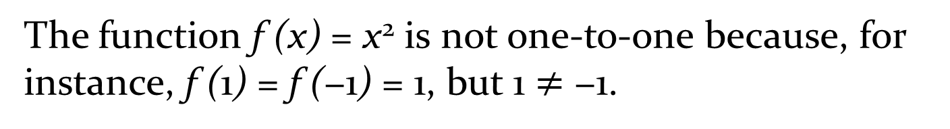
Example 2:
Determine whether the function f (x) = x² from the set of integers to the set of integers is one-to-one.
The function f (x) = x² is not one-to-one because, for instance, f (1) = f (−1) = 1, but 1 $≠$ −1.

Slide 3
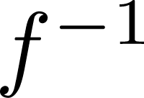
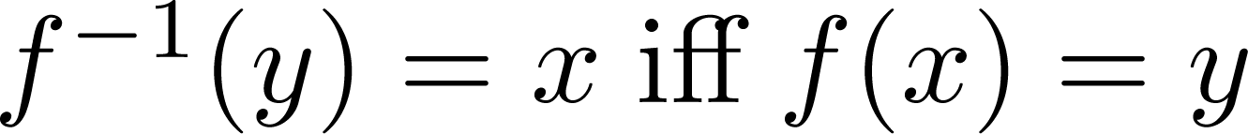
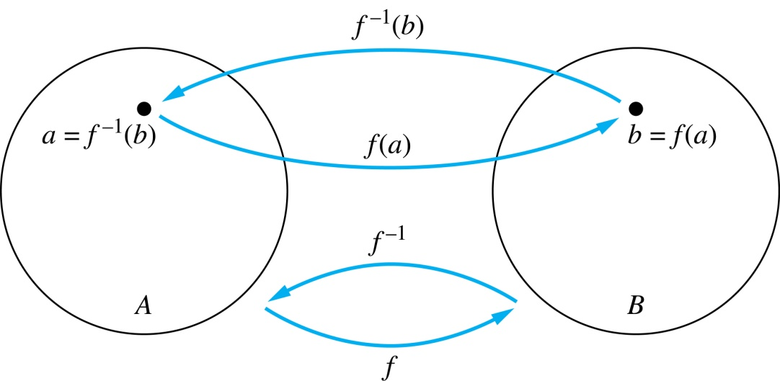
Inverse Functions
Definition: Let f be a bijection from A to B. Then the inverse of f, denoted , is the function from B to A defined as
No inverse exists unless f is a bijection. Why?

Slide 4
Inverse Functions
A
B
A
B
f
a
V
V
a
b
b
W
W
c
c
d
X
X
d
Y
Y

Slide 5
Questions
Example 1: Let f be the function from {a,b,c} to {1,2,3} such that f(a) = 2, f(b) = 3, and f(c) = 1. Is f invertible and if so what is its inverse?
Solution: The function f is invertible because it is a one-to-one correspondence. The inverse function f⁻¹ reverses the correspondence given by f, so f⁻¹ (1) = c, f⁻¹ (2) = a, and f⁻¹ (3) = b.

Slide 6
Questions
Example 2: Let f: Z → Z be such that f(x) = x + 1. Is f invertible, and if so, what is its inverse?
Solution: The function f is invertible because it is a one-to-one correspondence. The inverse function f⁻¹ reverses the correspondence so f⁻¹ (y) = y – 1.

Slide 7
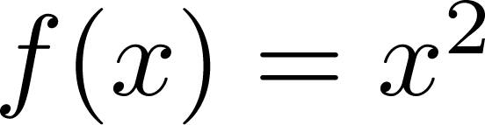
Questions
Example 3: Let f: R → R be such that . Is f invertible, and if so, what is its inverse?
Solution: The function f is not invertible because it is not one-to-one .

Slide 8
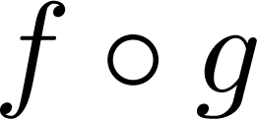
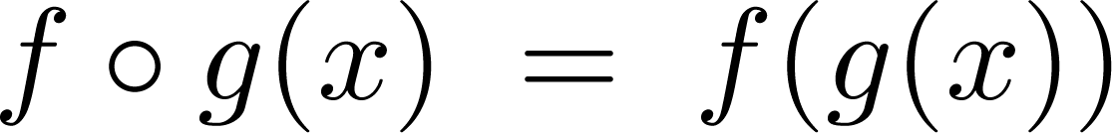
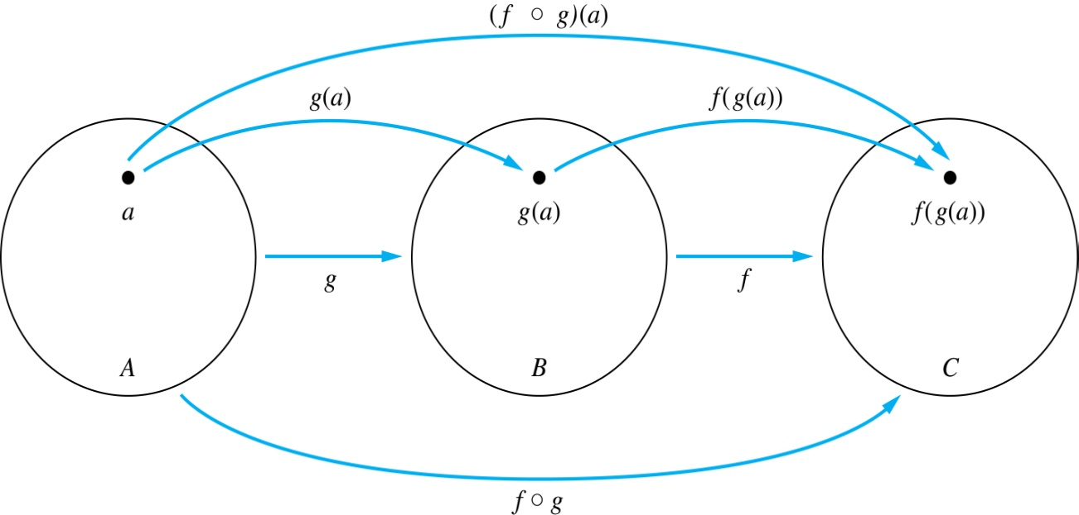
Composition
Definition: Let f: B → C, g: A → B. The composition of f with g, denoted is the function from A to C defined by

Slide 9
Composition
A
g
B
f
C
A
C
V
a
a
h
h
b
i
b
W
i
c
c
X
j
d
d
j
Y

Slide 10
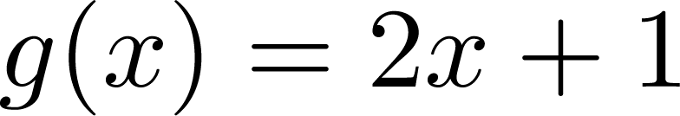
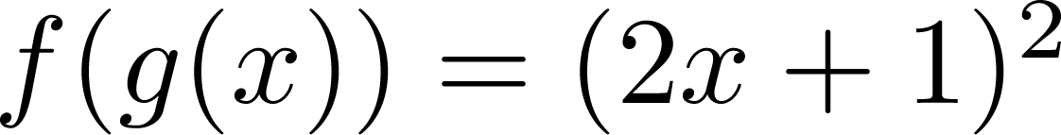
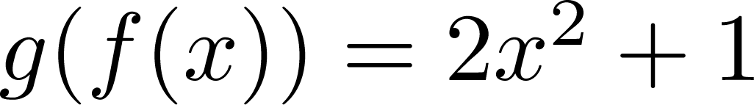
Composition
Example 1: If and , then
and

Slide 11
Composition Questions
Example 2: Let g be the function from the set {a,b,c} to itself such that g(a) = b, g(b) = c, and g(c) = a. Let f be the function from the set {a,b,c} to the set {1,2,3} such that f(a) = 3, f(b) = 2, and f(c) = 1.
What is the composition of f and g, and what is the composition of g and f.
Solution: The composition f∘g is defined by
f∘g (a)= f(g(a)) = f(b) = 2.
f∘g (b)= f(g(b)) = f(c) = 1.
f∘g (c)= f(g(c)) = f(a) = 3.
Note that g∘f is not defined, because the range of f is not a subset of the domain of g.

Slide 12
Composition Questions
Example 2: Let f and g be functions from the set of integers to the set of integers defined by f(x) = 2x + 3 and g(x) = 3x + 2.
What is the composition of f and g, and also the composition of g and f ?
Solution:
f∘g (x)= f(g(x)) = f(3x + 2) = 2(3x + 2) + 3 = 6x + 7
g∘f (x)= g(f(x)) = g(2x + 3) = 3(2x + 3) + 2 = 6x + 11

Slide 13
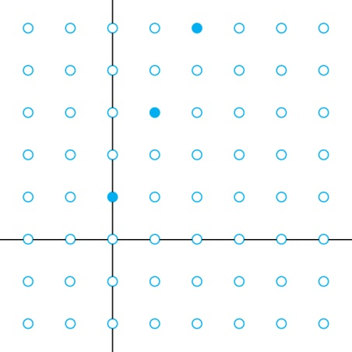
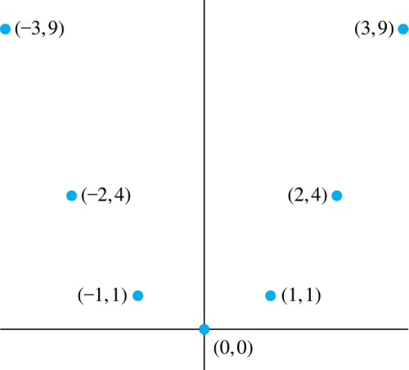
Graphs of Functions
Let f be a function from the set A to the set B. The graph of the function f is the set of ordered pairs {(a,b) | a ∈A and f(a) = b}.
Graph of f(n) = 2n + 1
from Z to Z
Graph of f(x) = x²
from Z to Z

Slide 14
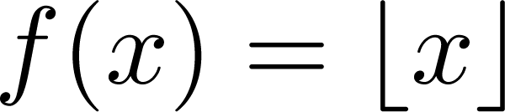
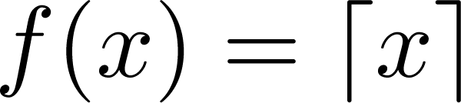
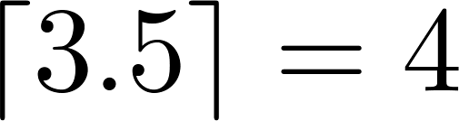
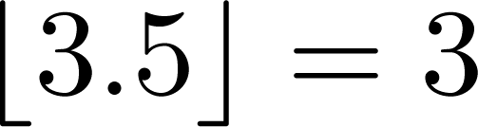
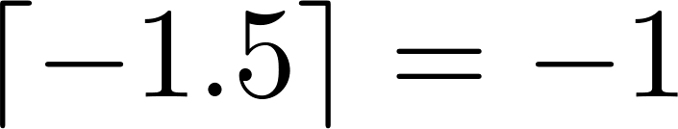
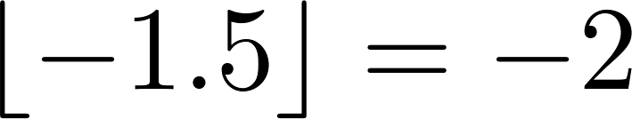
Some Important Functions
The floor function, denoted
is the largest integer less than or equal to x.
The ceiling function, denoted
is the smallest integer greater than or equal to x
Example:

Slide 15
Factorial Function
Definition: f: N → Z⁺ , denoted by f(n) = n! is the product of the first n positive integers when n is a nonnegative integer.
f(n) = 1 ∙ 2 ∙∙∙ (n – 1) ∙ n, f(0) = 0! = 1
Examples:
^{f(1) = 1! = 1}
^{f(2) = 2! = 1 ∙ 2 = 2}
^{f(6) = 6! = 1 ∙ 2 ∙ 3∙ 4∙ 5} ^{∙ 6 = 720}
f(20) = 2,432,902,008,176,640,000.

Slide 16
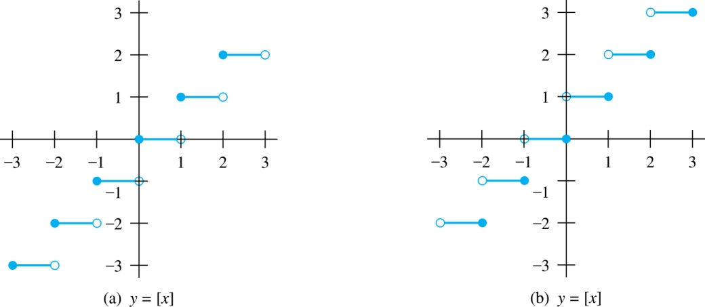
Floor and Ceiling Functions
Graph of (a) Floor and (b) Ceiling Functions

